Slide 1
Challenge 2
CS-EEE
Housekeeping:
Teaching team, plan and schedule

Slide 2
Instructors – Who’s Who?
Staff (EEE) | Staff (CS) | PGTAs
Thomas Gilbert | Steve Hailes | Hongwei Cui
Boli Chen | Matthew Caldwell | Sara Cender
 |  | Qianhao Zhan
 |  | Ruixuan Zhao
 |  | Junhao Liu
 |  | Borui Du
 |  | Shreevanth, Gopalakrishnan
 |  | Vedika Bedi
 |  | Guanyu Ren
 |  | James Hughes

Slide 3
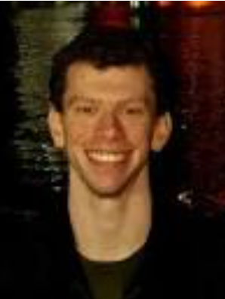
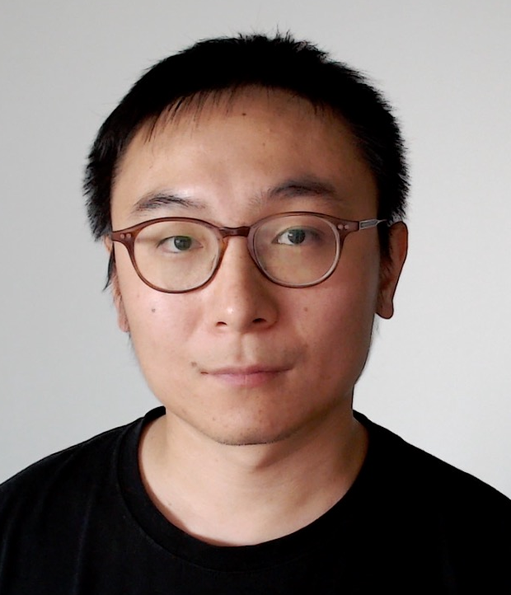
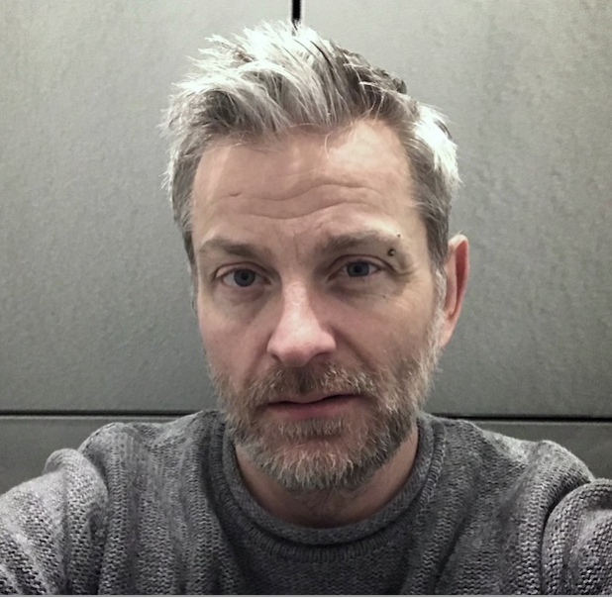
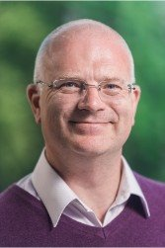
Instructors (Staff) – Who’s Who?
EEE
CS
Thomas
Gilbert
Boli
Chen
Matthew
Caldwell
Steve
Hailes

Slide 4
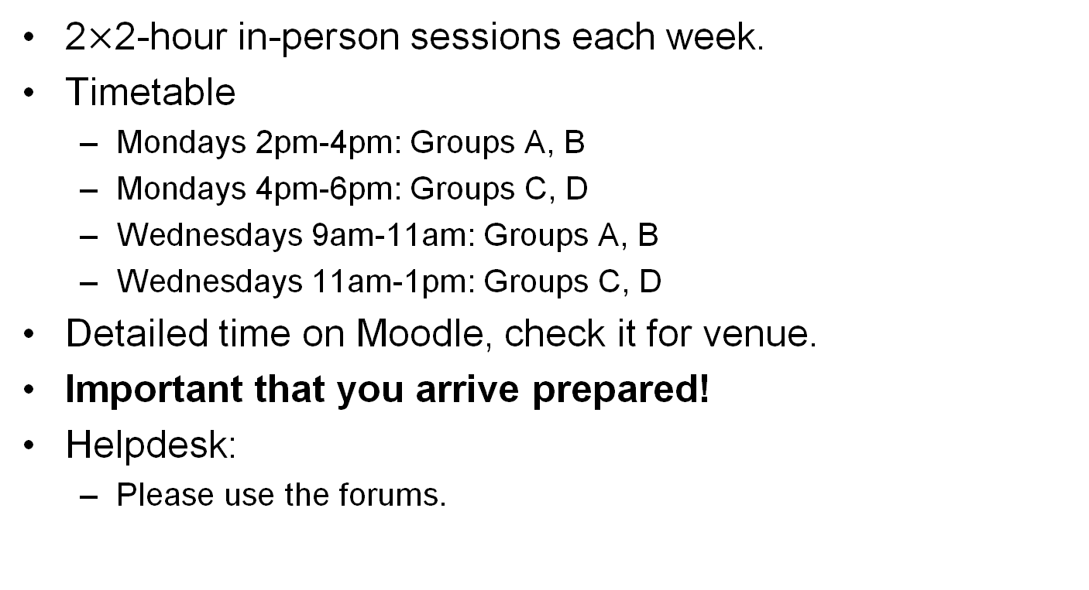
Plan
2$×$2-hour in-person sessions each week.
Timetable
  Mondays 2pm-4pm: Groups A, B
  Mondays 4pm-6pm: Groups C, D
  Wednesdays 9am-11am: Groups A, B
  Wednesdays 11am-1pm: Groups C, D
Detailed time on Moodle, check it for venue.
Important that you arrive prepared!
Helpdesk:
  Please use the forums.
Sustainable lab guide:
  Make sure you know how to correctly use the experimental equipment Do not attempt anything recklessly
  Microcontroller is for loan and must be returned at the end

Slide 5
Schedule
Term Week | Academic Week | Content
4 | 9 | Introduction to the project, communication, roles and tasks. Design modelling and tools. Showcase testbed.
5 | 10 | Introduction to the design techniques. Preparation for project proposal. Assign team roles. Ideally, pairing a CS and an EEE student for each subsystem, and this will be recorded Team proposal presentation
 | 11 | Reading Week
6-9 | 12-15 | Integration and testing methodology. Implementation, testing and integration in action.
10 | 16 | Team demonstration +Prepare and submit final report.

Slide 6
Attendance policy
Attendance will be marked in the first 20 minutes of the session
Challenge 2 works on a 3-strike system
If you are marked absent without reason for 3 sessions you will receive NO MARKS for Challenge 2

